Slide 1
Term Project Documentation: Analyzing The New York Times Chinese Edition
B08102068 Koga Takahashi

Slide 2
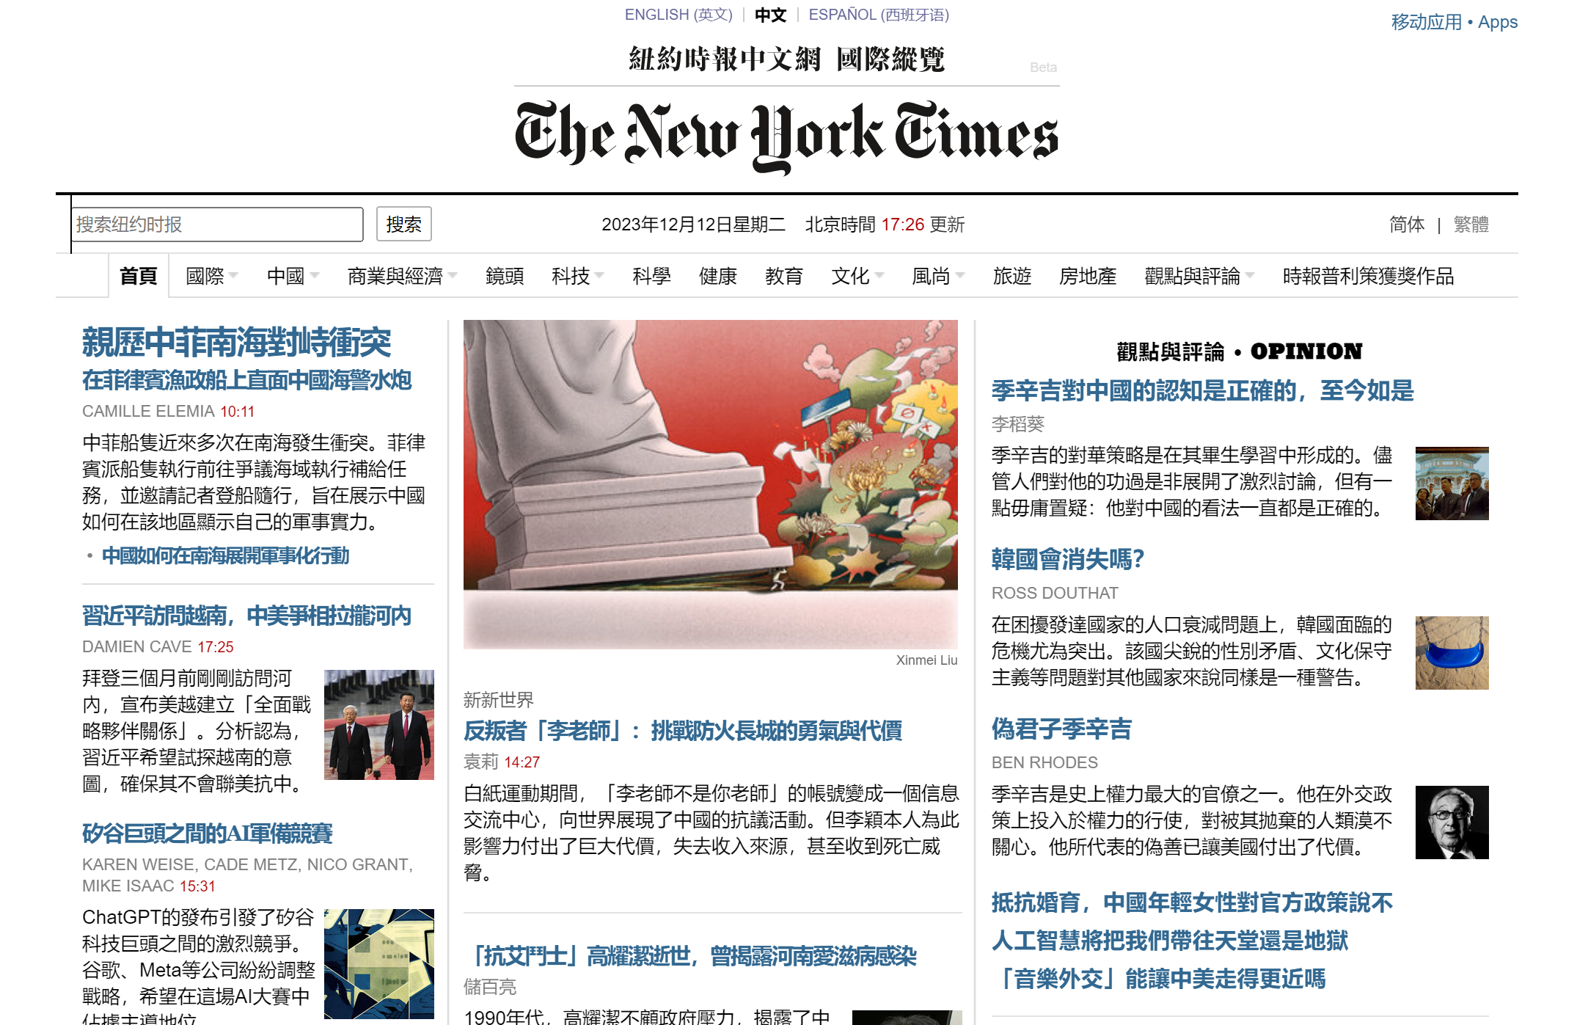
Website Chosen: 紐約時報中文網
The bilingual website I chose is “https://cn.nytimes.com/zh-hant/”

Slide 3
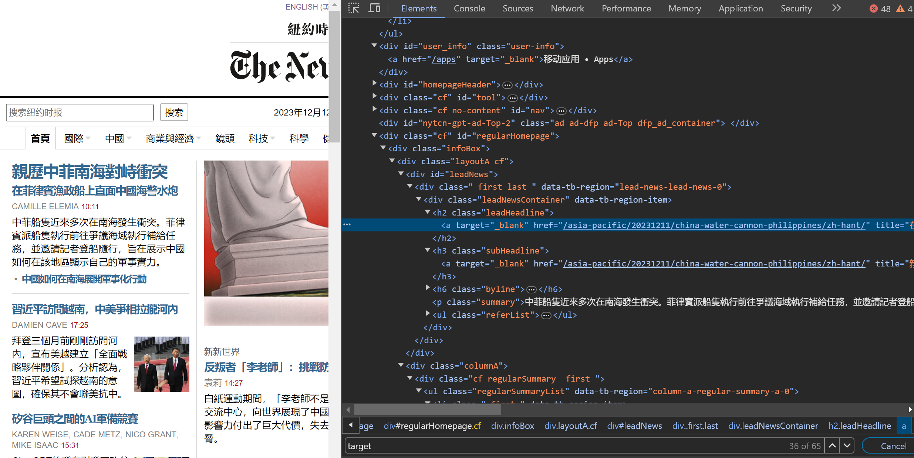
Analysis - Getting the Latest Articles
1. Understand the meaning of different tags in “Inspect”

Slide 4
<a target="_blank" href="/asia-pacific/20231211/china-water-cannon-philippines/zh-hant/" title="在菲律賓漁政船上直面中國海警水炮">親歷中菲南海對峙衝突</a>
<a target="_blank" href="/china/20231212/china-vietnam-xi-jinping/zh-hant/" title="習近平訪問越南，中美爭相拉攏河內">習近平訪問越南，中美爭相拉攏河內</a>
<a target="_blank" href="/technology/20231212/ai-chatgpt-google-meta/zh-hant/" title="矽谷巨頭之間的AI軍備競賽">矽谷巨頭之間的AI軍備競賽</a>
<a target="_blank" href="/world/20231208/china-eu-xi-michel/zh-hant/" title="歐盟就貿易和俄羅斯問題向中國施壓">歐盟就貿易和俄羅斯問題向中國施壓</a>
<a target="_blank" href="/opinion/20231207/kissinger-china-legacy/zh-hant/" title="季辛吉對中國的認知是正確的，至今如是">季辛吉對中國的認知是正確的，至今如是</a>
Observations
The red texts refer to the genre.
The 8-digit refer to the date, which can be used to sort html files when downloading.
All the urls end with /zh-hant/.

Slide 5
Author, Publication date, Titles
Author:
<meta id="byline" name="byline" content="CAMILLE ELEMIA">
Publication Date:
<meta id="date" name="date" content="2023-12-12T10:11:02.000Z">
Titles:
<h1>在菲律宾渔政船上直面中国海警水炮</h1><h1 class="en-title">What It Feels Like to Be the Target of China’s Water Cannons</h1>

Slide 6
Web scraping strategy (latest articles)
I decided to download all the articles on the home page of New York Times Chinese version since most of the articles on front page are published within a week.
Then I downloaded the html file of each article and saved it based on the date published, which is extracted from the 8-digit in the url.
Example: The html file of https://cn.nytimes.com/asia-pacific/20231211/china-water-cannon-philippines/zh-hant/ will be saved in “./2023/12-11/”

Slide 7
How to convert the website to the bilingual version:
https://cn.nytimes.com/asia-pacific/20231211/china-water-cannon-philippines/zh-hant/
https://cn.nytimes.com/asia-pacific/20231211/china-water-cannon-philippines/dual/
Replace “zh-hant/” with “dual/” using Python function .replace()

Slide 8
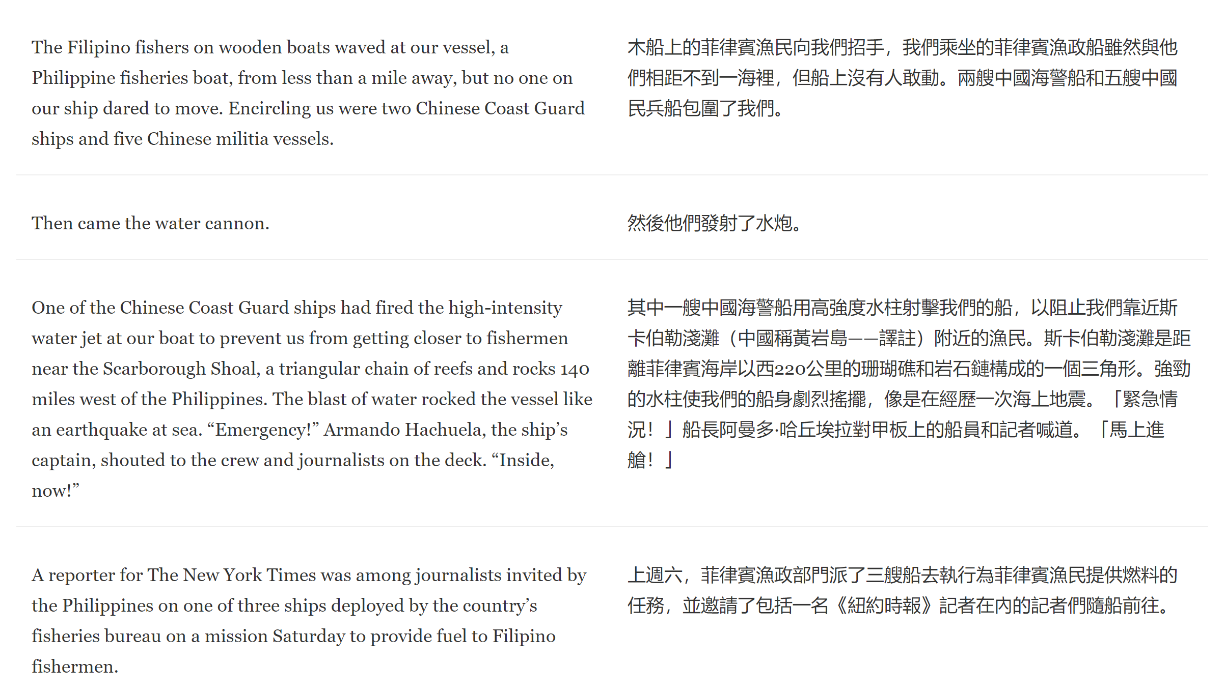
Analyzing the bilingual article
In the bilingual article, the English text and Chinese text are already aligned with each other. (And I was not successful at using Bertalign so I skipped this part)
Instead, tried to download the English text and the Chinese text seperately.

Slide 9
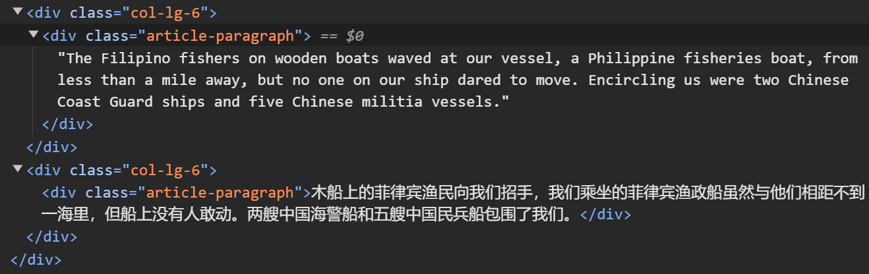
But I encounter a problem: As shown in the image below, both English and Chinese had the same name of the class, called <div class=“article-paragraph” >, so it was not possible to differentiate the language just by the class. Then I realized the paragraphs are consistently ordered with English text in the odd-numbered <div> elements and Chinese text in the even-numbered ones, so I can differentiate them based on their position in the sequence. For example, the English text appear in the first and third <div> element and the Chinese text appear in the second and fourth ones.

Slide 10
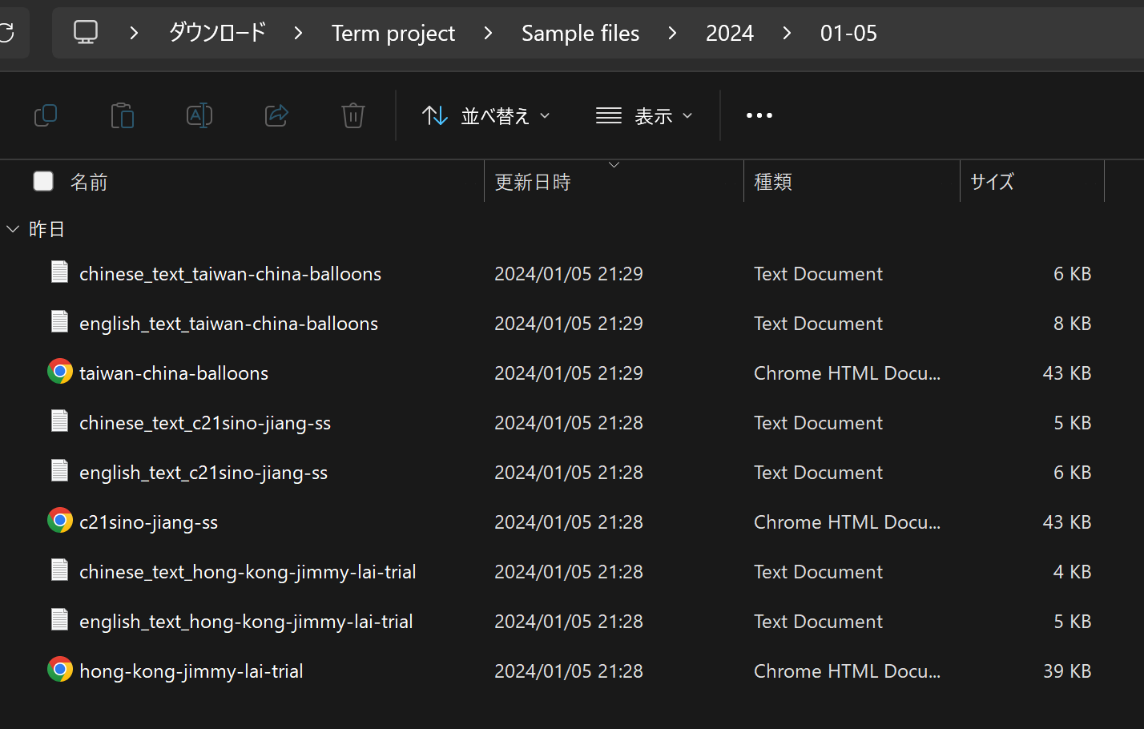
Organzation of the downloaded files
I downloaded English file and Chinese text file seperately, in the same “date” folder as the html file of the article.
Path: ./2014/01-05

